Slide 1
Get partner details
Based on the user input, read data from excel file, convert the required data to JSON and generate an SNRF

Slide 2
Console app:
Context:
Read user input
Configure settings value
Read data from source - LINQ
Dependency injection for dependent service from Program.cs
Fetch required partner details from data
Validation
JSON serializer
SNRF generation and printing

Slide 3
Reading user input types:
String:
Console.ReadLine() – reads user input until enter, always reads as string
Numbers:
int value = int.Parse(Console.ReadLine())
double value = double.Parse(Console.ReadLine())
Parse will crash when entered invalid input
Single character:
Console.Read() reads single character and returns ASCII value (int) and does not wait for enter
int ch = Console.Read();
Single key press:
Console.ReadKey() accepts single key press and does not wait for enter
Returns a ConsoleKeyInfo object
ConsoleKeyInfo key = Console.ReadKey();
Console.WriteLine("\nKey pressed: " + key.Key);
Where key.Key returns the key pressed – ConsoleKey.A
Where key.KeyChar returns the actual char like ‘A’ when shift+A is pressed
Where key. Modifiers returns the special functions like shift as ConsoleModifiers.Shift and none when just the key was pressed

Slide 4
Safe input read:
Try parse for safe input without crashing:
Bool success = int.TryParse(Console.ReadLine(), out int age)
If(success) Console.WriteLine(“Age is ” +age);
Else Console.WriteLine(“Provide valid value”);
Try parse returns true or false and stored to output parameter
Console.WriteLine(age);
When we try to print age directly, it will be assigned with default value 0 when false
But it is dangerous, because when user types ABC, it will be taken as 0 (bug)
Hence, loop until we get a valid value with while loop or use if-else condition
while(!int.TryParse(Console.ReadLine(), out age))
Console.WriteLine("Enter a valid number:");

Slide 5
App config:
var config = new ConfigurationBuilder()
.SetBasePath(AppContext.BaseDirectory)
.AddJsonFile("appsettings.json", optional: false, reloadOnChange: true)
.Build();
Config = SAB (set – add – build)
Fetch the value from file using config[“{var_name}”]
Install the following NuGet packages to perform this task:
<PackageReference Include="Microsoft.Extensions.Configuration" Version="10.0.2" />
<PackageReference Include="Microsoft.Extensions.Configuration.FileExtensions" Version="10.0.2" />
<PackageReference Include="Microsoft.Extensions.Configuration.Json" Version="10.0.2" />

Slide 6
Creates a configuration builder object
Sets the folder location where config files are searched (bin\Debug\net10.0)
  Copy the file to this folder when created. Right click -> Properties -> CopyToOutputDir: CopyIfNewer
Adds the file with settings: optional – when file is missing, app crashes and If when file is changed while app is running, config auto reloads
.Build() finalizes everything and builds the actual objectThe other types of add includes . AddEnvironmentVariables(), .AddCommandLine(args), . AddInMemoryCollection({})
Priority matters as the last add overrides the earlier ones.

Slide 7
JSON Serialize:
Console.WriteLine(JsonSerializer.Serialize(
partnerDetails,
new JsonSerializerOptions { WriteIndented = true }
));
JSONSerializer is a class from System.Text.Json and .Serialize which converts the object to JSON string
new creates an in memory object or instance for the class
JsonSerializerOptions controls how JSON is created or read. Its options are as below:
  WriteIntended= true -> beautifies the JSON
  PropertyNamingPolicy = JsonNamingPolicy.CamelCase -> converts field names to camelCase
  PropertyNameCaseInsensitive = true
  DefaultIgnoreCondition = JsonIgnoreCondition.WhenWritingNull removes null from JSON
  NumberHandling = JsonNumberHandling.AllowReadingFromString translates string to int or value

Slide 8
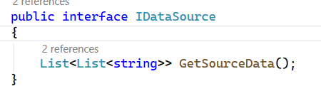
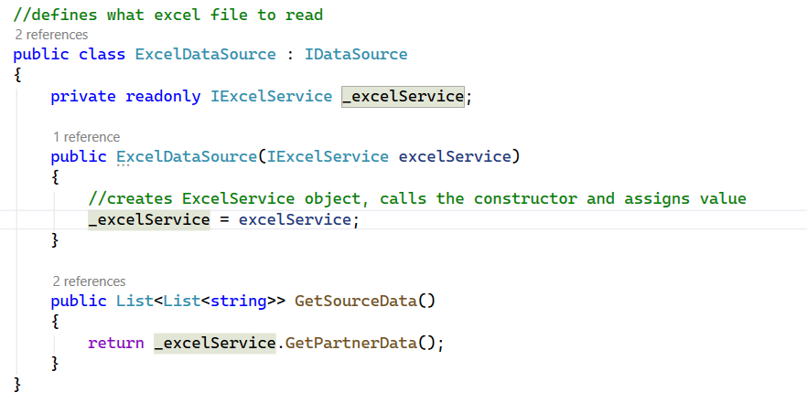
Read data from source
Data is currently from Excel file. But it can be from DB or any other source later. Hence, we need to use interface concept.
Interface will have only the method contracts to be implemented in derived class. The method should be same across all the implemented classes.
When the implemented class has dependent service, it is best to initialize object as readonly in implemented class. Means it can be assigned only once in declarative or in constructor.

Slide 9
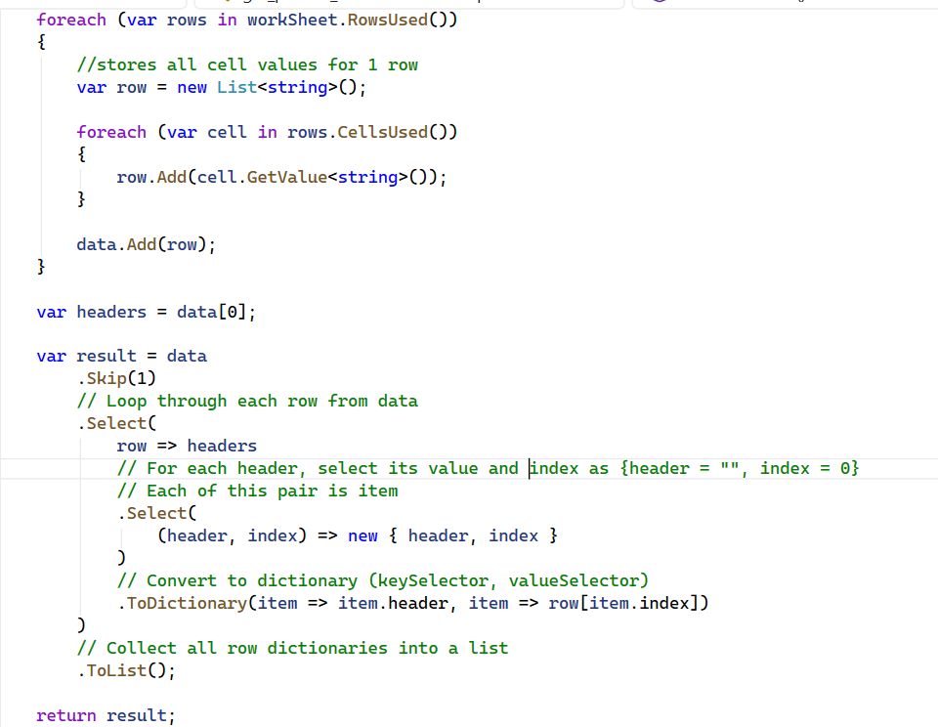
LINQ:
LINQ allows us to iterate over collections and filter data.

Slide 10
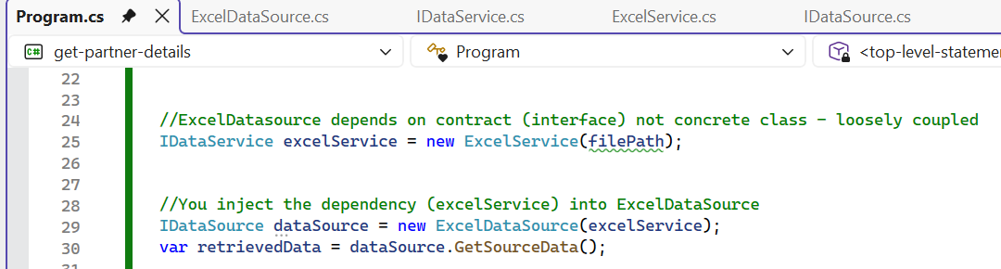
Dependency injection:
Dependency Injection means dependencies are provided to a class from outside instead of being created inside the class.
Here, ExcelDataSource depends on ExcelService to retrieve data. Hence create an object for ExcelService from main program and inject it to ExcelDataSource.
Note: To not be directly dependent on ExcelService, we have IDataService and ExcelService implements it.

Slide 11
ExcelService:
Install ClosedXML.Excel NuGet package - A library used to read and write Excel (.xlsx) files without needing Excel installed.
var workBook = new XLWorkbook(_filepath); -> opens the file, stores in memory and creates object.
var workSheet = workBook.Worksheet(1); -> gets the worksheet from the workbook.
var rows in workSheet.RowsUsed() -> displays all the non-blank rows.
var cell in rows.CellsUsed() -> takes all the non-blank cells in the row.
row.Add(cell.GetValue<string>()); -> adds the cell value as a string.

Slide 12
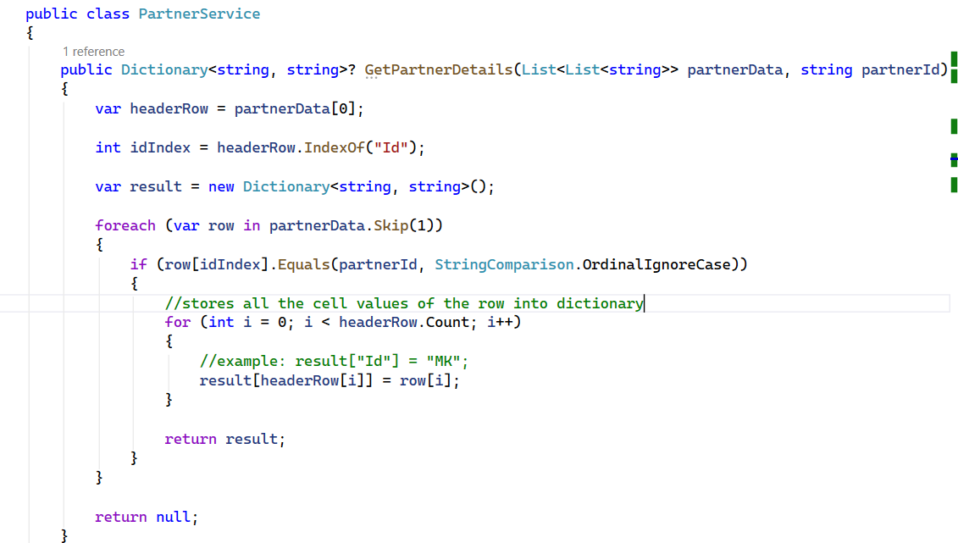
Fetch required partner details from data:
PartnerDetails is pure business logic and not dependent on any other service, hence DI not required.
var row in partnerData.Skip(1) is a LINQ statement, hence import this using statement.
row[idIndex].Equals(partnerId, StringComparison.OrdinalIgnoreCase) compares ignores cases.

Slide 13
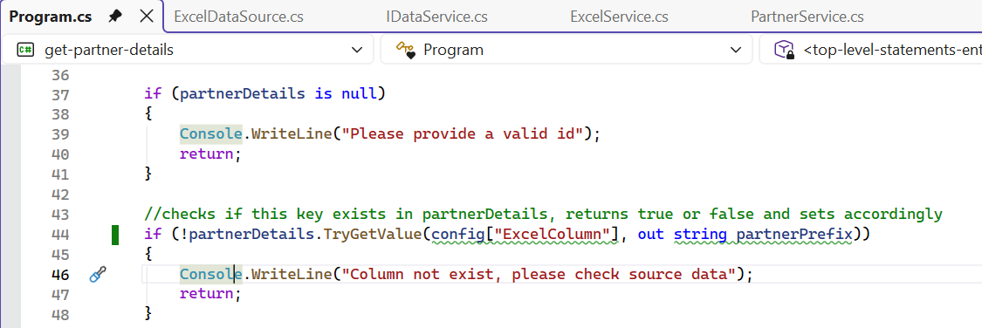
Validation:
if (!partnerDetails.TryGetValue(config["ExcelColumn"], out string partnerPrefix))
TryGetValue is a function of dictionary. It checks if the key exists then appends its value to output parameter.

Slide 14
SNRF generation:
DateTime:
string currentDate = DateTime.UtcNow.Ticks
.ToString("X")[..4];
ToString(“X”) converts to hexadecimal (0-9, A-F) X for capital case and x for small case.
[..4] takes first 4 characters. [^4..] takes the last 4 characters.
Random number:
string randomNumber = Random.Shared.Next(1, 10000).ToString("D4");
Shared uses singleton instance for Random class in the program.
ToString("D4") represents Decimal with padding 0s for length 4

